Slide 1
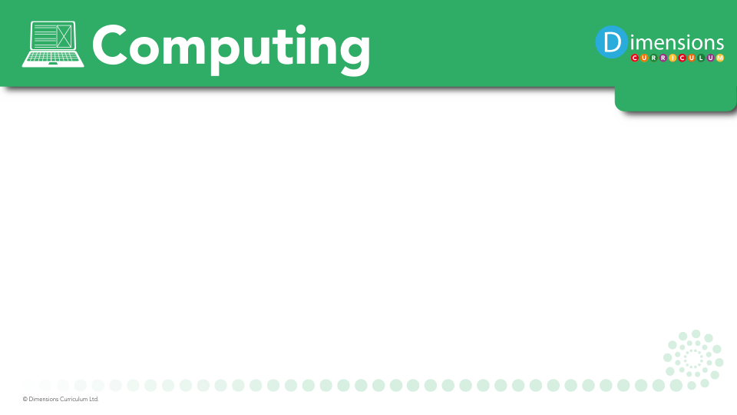

Slide 2
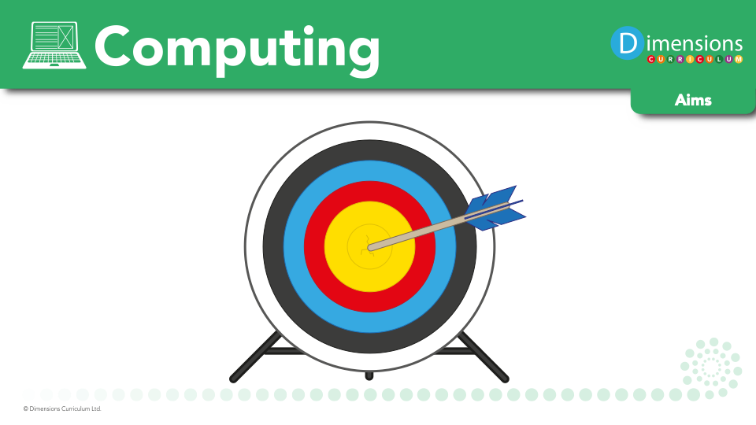

Slide 3

Computing encourages pupils to use logical reasoning to predict the behaviour of simple programs.

Slide 4
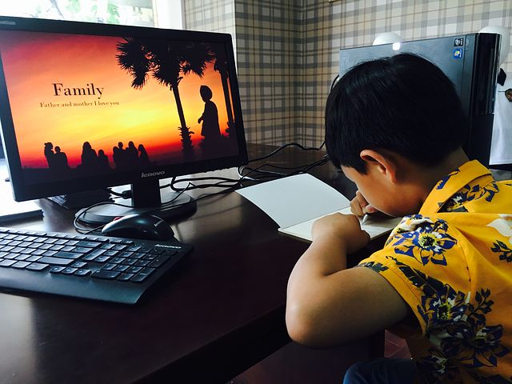
Computing encourages pupils to develop a richer digital literacy experience, as they document what they know and learn for others through blog posts, audio recordings etc.

Slide 5

Computing nurtures pupils’ collaboration skills, as they work together and support one another in their learning.

Slide 6

Computing develops pupils’ skills in using technology to create, organise, store, manipulate and retrieve digital content.

Slide 7

Critical thinking and
analytical skills are developed through computing.

Slide 8
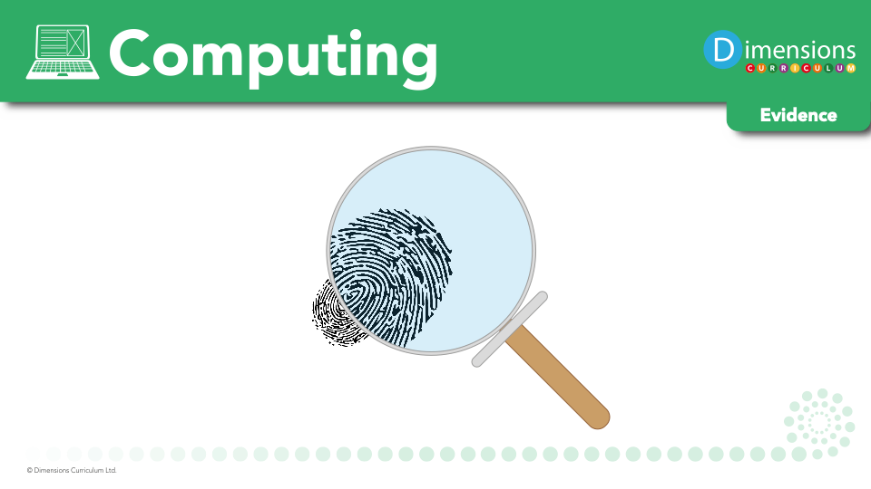

Slide 9
